Slide 1
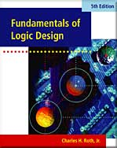
CHAPTER 18
Circuits for Arithmetic Operations
This chapter in the book includes:
Objectives
Study Guide
18.1 Serial Adder with Accumulator
18.2 Design of a Parallel Multiplier
18.3 Design of a Binary Divider
Programmed Exercises
Problems

Slide 2
Objectives
1. Analyze and explain the operation of various circuits for adding, subtracting,
multiplying, and dividing binary numbers and for similar operations.
2. Draw a block diagram and design the control circuit for various circuits
for adding, subtracting, multiplying, and dividing binary numbers and for
similar operations.

Slide 3
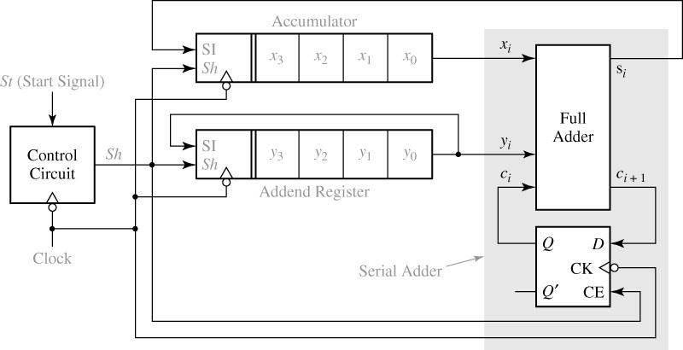
18.1 Serial Adder with Accumulator
Fig 18-1. Block Diagram for Serial Adder with Accumulator

Slide 4
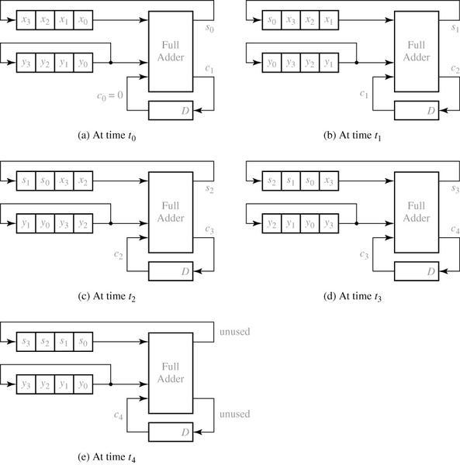
18.1 Serial Adder with Accumulator
Fig 18-2. Operation of Serial Adder

Slide 5
18.1 Serial Adder with Accumulator
Table 18-1: Operation of Serial Adder
 | X | Y | C_{i} | S_{i} | C_{i}⁺
t₀ t₁ t₂ t₃ t₄ | 0101 0010 0001 1000 1100 | 0111 1011 1101 1110 0111 | 0 1 1 1 0 | 0 0 1 1 (1) | 1 1 1 0 (0)

Slide 6
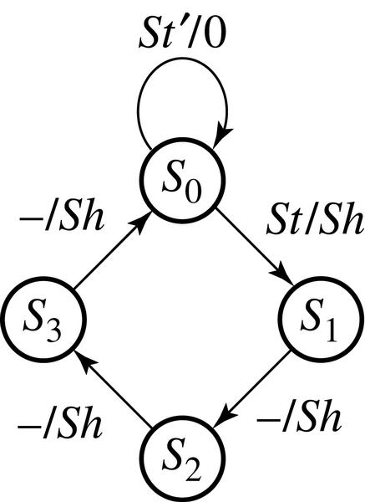
18.1 Serial Adder with Accumulator
Fig 18-3. State Graph for Serial Adder Control
 | Next State |  | Sh
 | St = 0 | 1 | 0 | 1
S₀ S₁ S₂ S₃ | S₀ S₁ S₂ S₃ | S₁ S₂ S₃ S₀ | 0 1 1 1 | 1 1 1 1

Slide 7
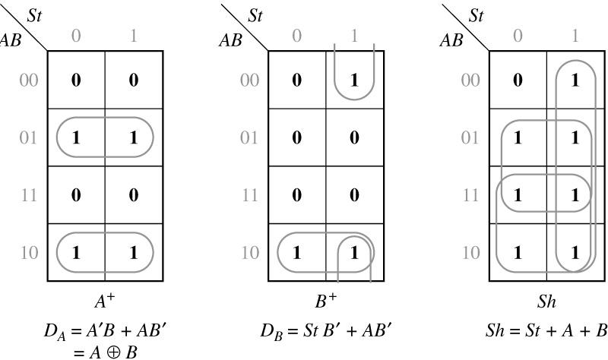
18.1 Serial Adder with Accumulator
Fig 18-4. Derivation of Control Circuit Equations
 | AB | A⁺B⁺
 |  | 0 | 1
S₀ S₁ S₂ S₃ | 00 01 10 11 | 00 10 11 00 | 01 10 11 00

Slide 8
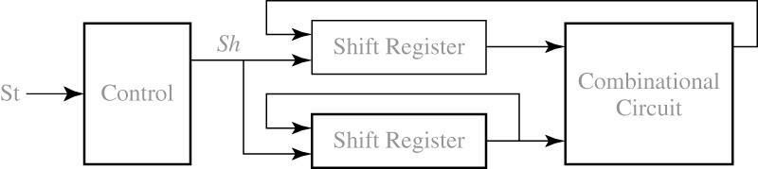
18.1 Serial Adder with Accumulator
Fig 18-5. Typical Serial Processing Unit

Slide 9
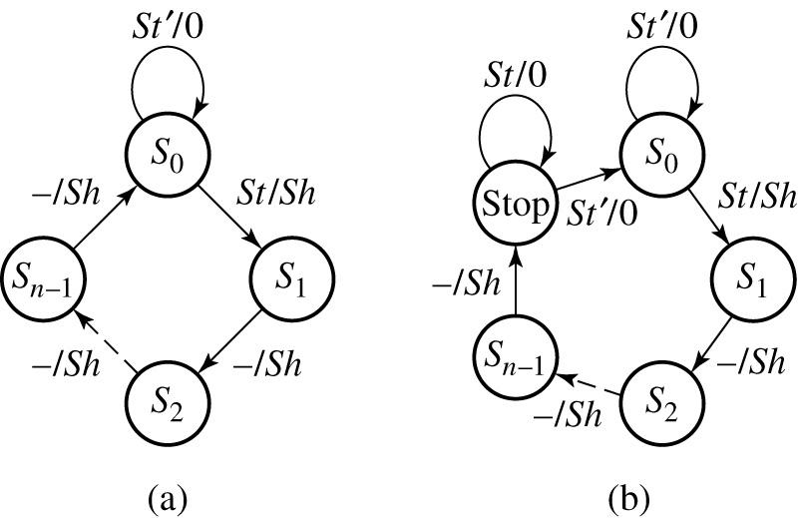
18.1 Serial Adder with Accumulator
Fig 18-6. State Graphs for Serial Processing Unit

Slide 10
18.2 Design of a Parallel Multiplier
Example of 13 x 11
Multiplicand
1 1 0 1 (13)
1 1 0 1 (11)
1 1 0 1
1 1 0 1
1 0 0 1 1 1
0 0 0 0
1 0 0 1 1 1
1 1 0 1
1 0 0 0 1 1 1 1 (143)
Multiplier
Partial
Products
Product

Slide 11
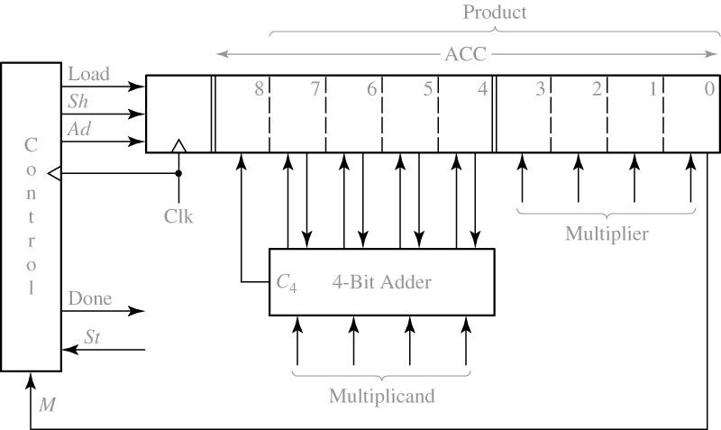
18.2 Design of a Parallel Multiplier
Fig 18-7. Block Diagram for Parallel Binary Multiplier

Slide 12
18.2 Design of a Parallel Multiplier
initial contents of product register
(add multiplicand because M=1)
after addition
after shift
(add multiplicand because M=1)
after addition
after shift
(skip addition because M=0)
after shift
(add multiplicand because M=1
after addition
after shift (final answer)
dividing line between product and multiplier
0 0 0 0 0 1 0 1 1 ← M (11)
1 1 0 1 (13)
0 1 1 0 1 1 0 1 1
0 0 1 1 0 1 1 0 1 ← M
1 1 0 1
1 0 0 1 1 1 1 0 1
0 1 0 0 1 1 1 1 0 ← M
0 0 1 0 0 1 1 1 1 ← M
1 1 0 1
1 0 0 0 1 1 1 1 1
0 1 0 0 0 1 1 1 1 (143)

Slide 13
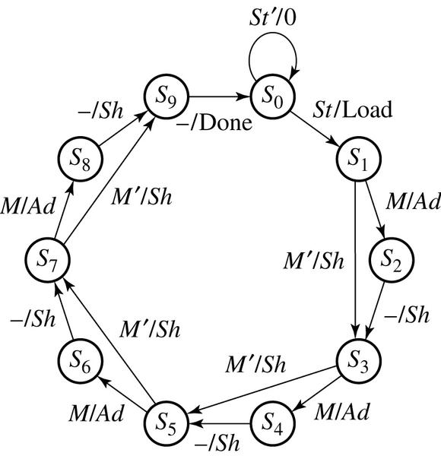
18.2 Design of a Parallel Multiplier
Fig 18-8. State Graph for Multiplier Control

Slide 14
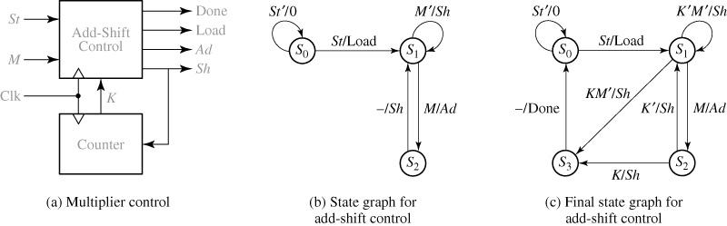
18.2 Design of a Parallel Multiplier
Fig 18-9 : State reduction Using Counter

Slide 15
18.2 Design of a Parallel Multiplier
Table 18-2. Operation of a Multiplier Using a Counter
Time | State | Counter | Product Register
 |  |  |  | St | M | K | Load | Ad | Sh | Done
t_{o} t₁ t₂ t₃ t₄ t₅ t₆ t₇ t₈ t₉ | S_{o} S₁ S₂ S₃ S₄ S₅ S₆ S₇ S₈ S₉ | 00 00 00 00 01 01 10 11 11 00 | 000000000 000000000 000001011 011011011 001101101 100111101 010011110 001001111 100011111 010001111 | 0 1 0 0 0 0 0 0 0 0 | 0 0 1 1 1 1 0 1 1 1 | 0 0 0 0 0 0 0 1 1 0 | 0 1 0 0 0 0 0 0 0 0 | 0 0 1 0 1 0 0 1 0 0 | 0 0 0 1 0 1 1 0 1 0 | 0 0 0 0 0 0 0 0 0 1

Slide 16
18.3 Design of a Binary Divider
1 0 1 0 quotient
1 0 0 0 0 1 1 1 dividend
1 1 0 1
0 1 1 1
0 0 0 0
1 1 1 1
1 1 0 1
0 1 0 1
0 0 0 0
0 1 0 1 remainder
divisor 1 1 0 1
( 135 ÷ 13 = 10 with
a remainder of 5 )

Slide 17
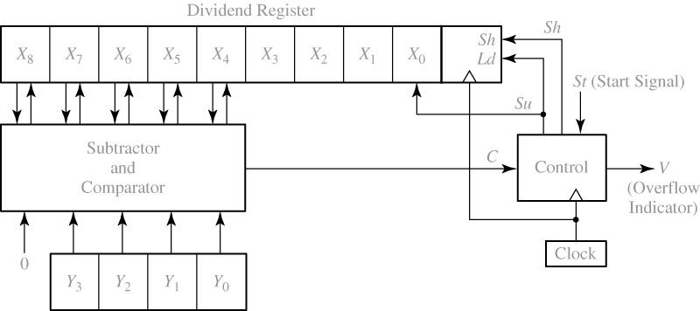
18.3 Design of a Binary Divider
Fig 18-10. Block Diagram for Parallel Binary Divider

Slide 18
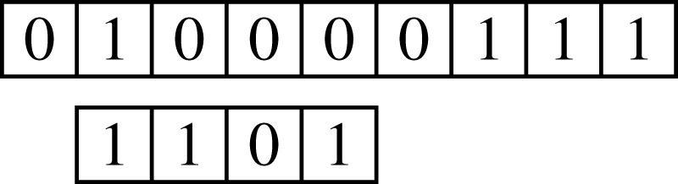
18.3 Design of a Binary Divider
Example. 135 divided by 13
Dividing line between dividend and quotient
1 0 0 0 0 1 1 1 0
1 1 0 1 Note that after the shift, the rightmost position in the
dividend register is “empty”
0 0 0 1 1 1 1 1 1 First quotient digit
continue…

Slide 19
18.3 Design of a Binary Divider
0 0 1 1 1 1 1 1 0
1 1 0 1
0 0 0 1 0 1 1 0 1 Third quotient digit
0 0 1 0 1 1 0 1 0
remainder quotient
initial contents of the registers of 135 divided by 7
0 1 0 0 0 0 1 1 1
0 1 1 1

Slide 20
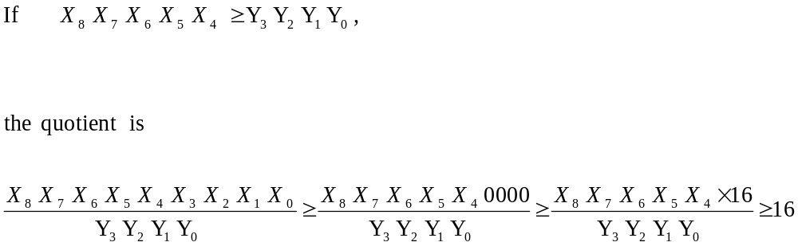
18.3 Design of a Binary Divider
Quotient of Fig 18-10: Overflow condition

Slide 21
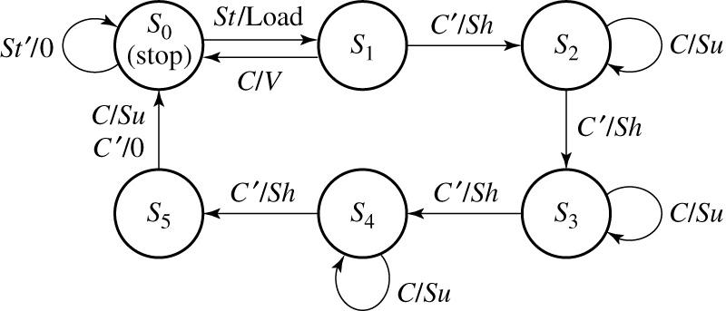
18.3 Design of a Binary Divider
Fig 18-11. State Graph for Divider Control Circuit

Slide 22
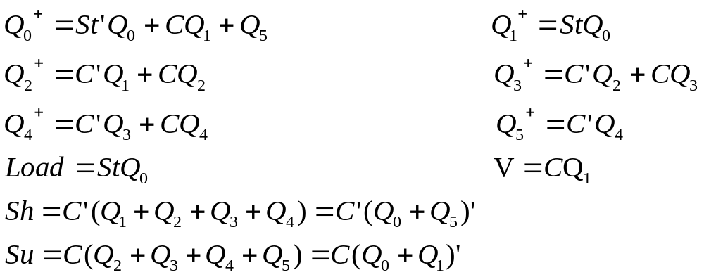
18.3 Design of a Binary Divider
One flip-flop is used for each state with
by inspection, The next-state and output equation

Slide 23
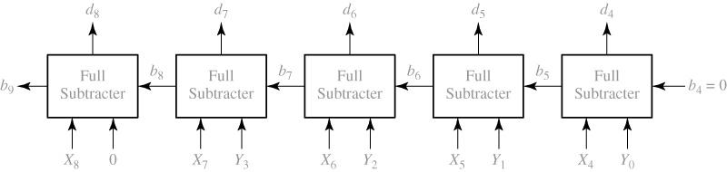
18.3 Design of a Binary Divider
Fig 18-12. Logic Diagram for 5-Bit Subtracter

Slide 24
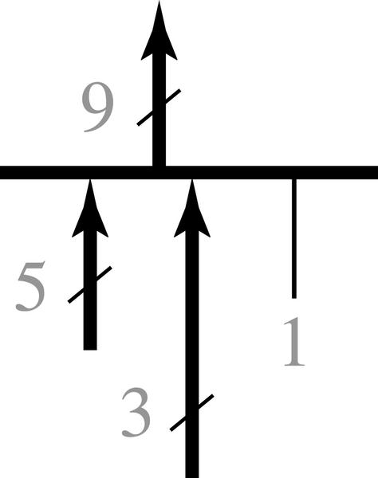


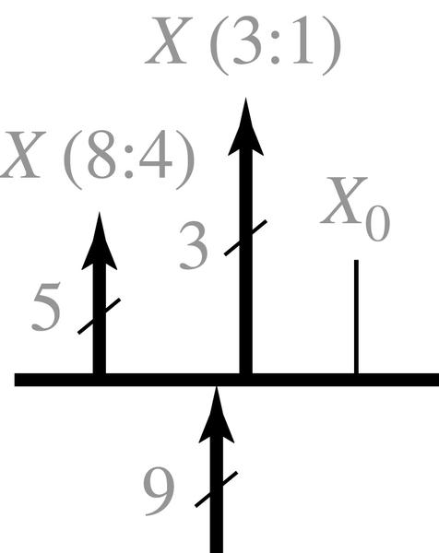


18.3 Design of a Binary Divider
5-bit subtracter output is merged with bits
a logic 1 to form a 9-bit bus.
the MUX output will be when Load = 0
A bus splitter that splits the 9bits from the X register into
and ; is not used.

Slide 25
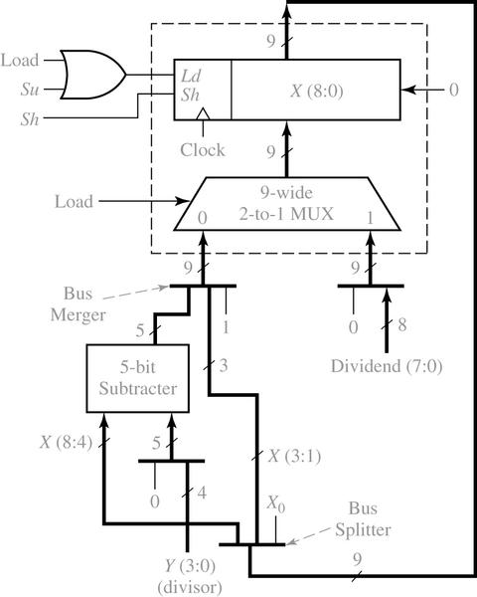
18.3 Design of a Binary Divider
Fig 18-13. Block Diagram for Divider Using Bus Notation

Slide 26
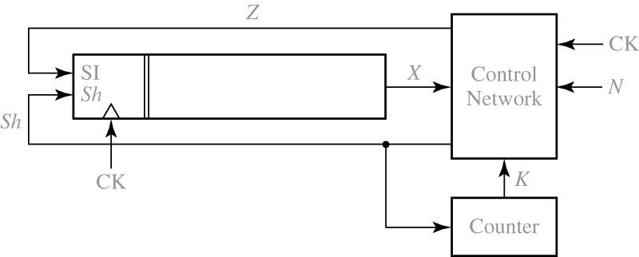
Programmed Exercises 18.1
State a rule for forming the 2’s complement which is appropriate for use with the preceding block diagram

Slide 27
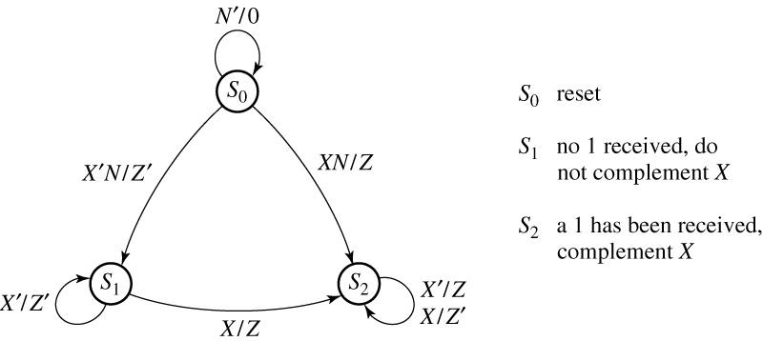
Programmed Exercises 18.1

Slide 28
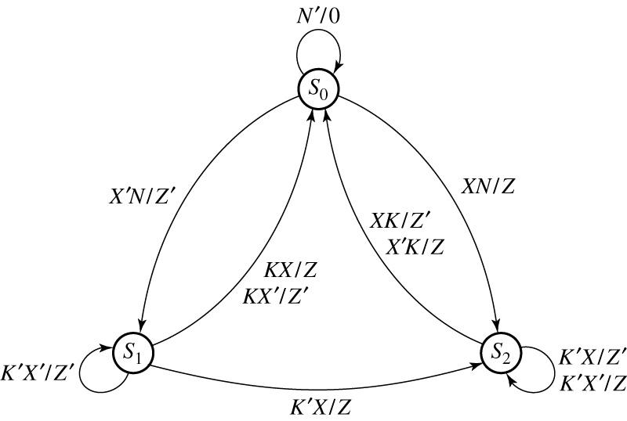
Programmed Exercises 18.1
Note : Sh should be added to the graph everywhere Z or Z’ appears

Slide 29
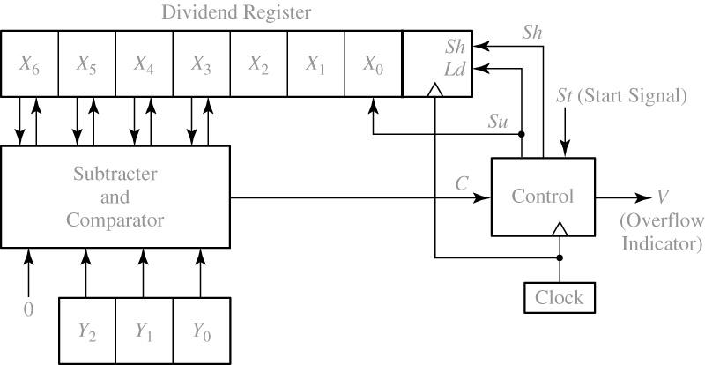
Programmed Exercises 18.2
This exercise concerns the design of a binary divider to divide a 6-bit number by a 3-bit number to find a 3-bit quotient. The right 3 bits of the dividend register should be used to store the quotient. Draw a block diagram for the divider. Omit the signals required to initially load the dividend register and assume the dividend is already loaded.

Slide 30
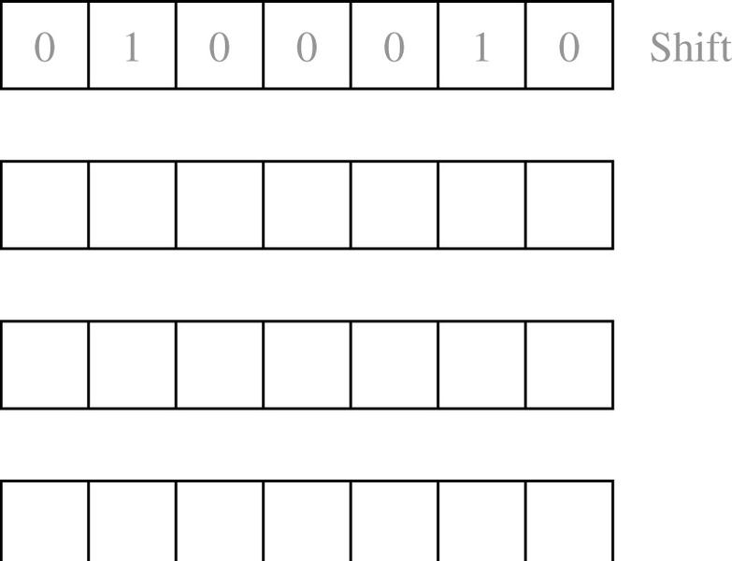
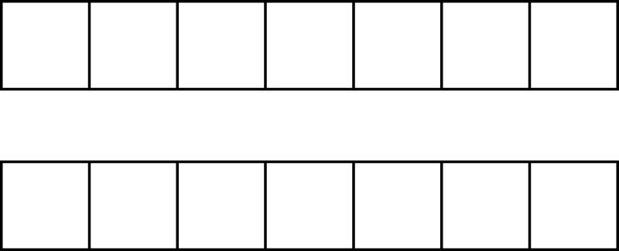
Programmed Exercises 18.2
If the contents of the dividend register is initially 0100010 and the divisor is 110,
show the contents of the dividend register after each of the first three rising clock edges.
Also, indicate whether a shift or a subtraction should occur next.
Now, show the remaining steps in the computation and
check your answer by converting to decimal.

Slide 31
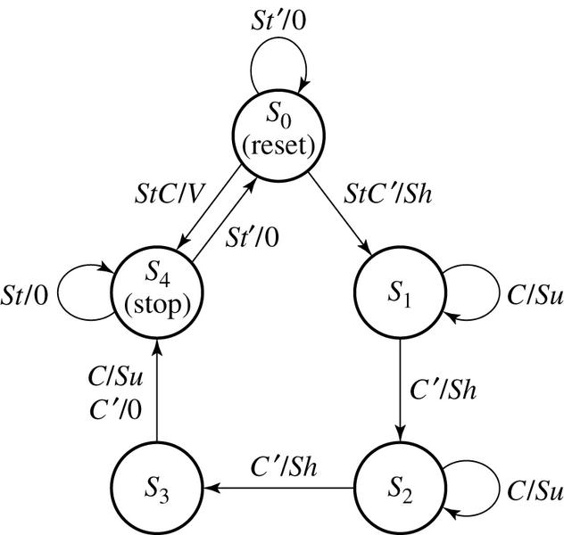
Programmed Exercises 18.2
Answer

